Slide 1
banknote authentication, part ii:
A survey of models, attacks, and defenses
Alice chang, yu chen, Karthik umashankar

Slide 2
outline
Previous work done
Background
Processing raw data
Our contribution
Experimenting with other models
Attacking the model
Next steps

Slide 3
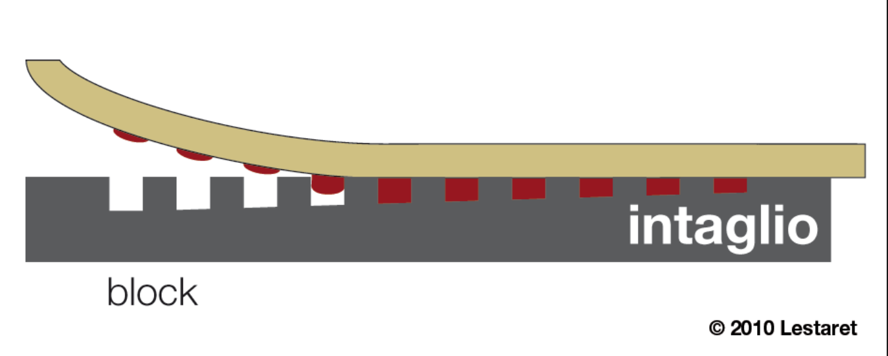
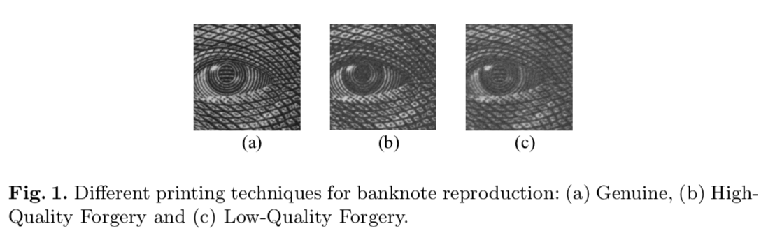
background
Basic premise: use the properties of Intaglio printing to differentiate between genuine bills from high-quality and low-quality forgeries.
The level of fine-grain detail is difficult to emulate, and is thus a good authentication feature.
several tons/cm² presses a feelable relief into the paper
ink

Slide 4
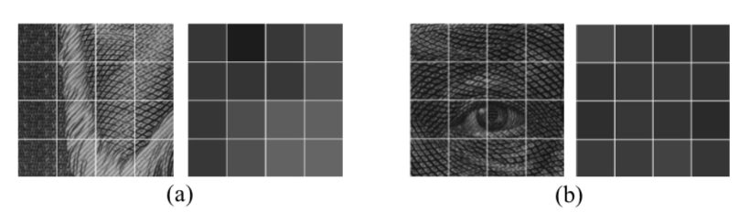
MACHINE LEARNING FOR FORGERY DETECTION
Pioneered by two researchers – Eugen Gillich and Volker Lohweg:
Leveraged Shift Invariant Wavelet Transform (SWT) + Support Vector Machine
Yielded 100% accuracy rate (threw out two outliers due to them being incomplete data points).
Four step process:
Image digitization using areas of homogeneous grayscale mean.
Preprocessing
Feature extraction
Classification

Slide 5
Feature processing (REGION OF INTEREST SELECTION)
1
2
Each Region of Interest was partitioned into 8 x 8 blocks, with each block’s grayscale value calculated.
ROIs with a combination of low variance and low mean grayscale values were targeted.
3
4
Calculate mean grayscale value, and find variance of ROI’s grayscale values.

Slide 6
Feature processing (SHIFT WAVELET TRANSFORM)
1
Shift Wavelet Transform to convert each ROI’s two-dimensional signal into a 2N x 2M matrix.
This matrix can be further partitioned into scaling coefficients (A), vertical detail (cV), horizontal detail (cH) and diagonal detail (cD) coefficients.
This was combined with a scaling factor α to generate cG (united detail coefficient).
2

Slide 7
Feature EXTRACTION
1
The unified coefficients were then plotted as histograms, with their mean, skewness, kurtosis, entropy used as the final features for the machine learning model.
Wavelet coefficients of Genuine banknotes tend to have fatter distributions than LQFs (low-quality forgeries).
2
3

Slide 8
THEIR FINDINGS
100% classification accuracy on test set using a polynomial kernel Support Vector Machine.
The gold standard for feature engineering: transformation of a rich, high-dimensional feature space into a linearly separable decision boundary.

Slide 9
Our FINDINGS: COMPARING CLASSIFIER MODELS
Comparison of models (KNN Classifier and Neural Network multi-layer perceptron classifier)
Performance metrics
Bias variance curves

Slide 10
Our FINDINGS: COMPARING CLASSIFIER MODELS
Comparison of models (KNN Classifier and Neural Network multi-layer perceptron classifier)
Performance metrics
Bias variance curves

Slide 11
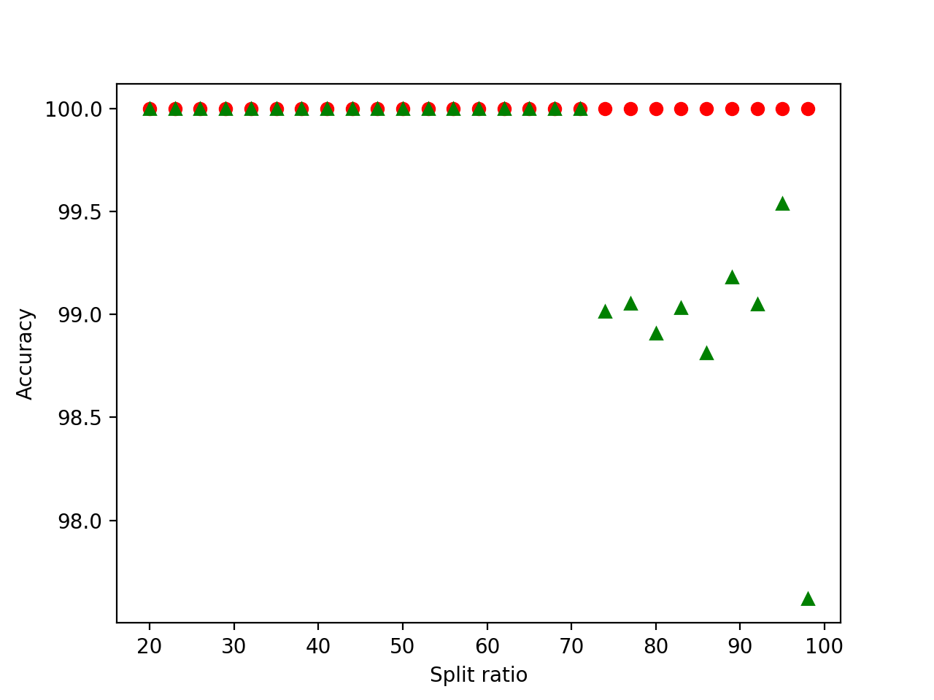
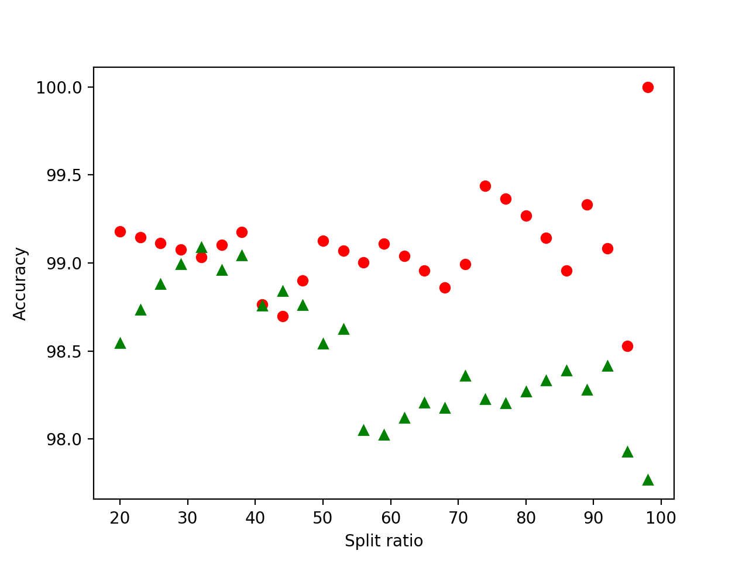
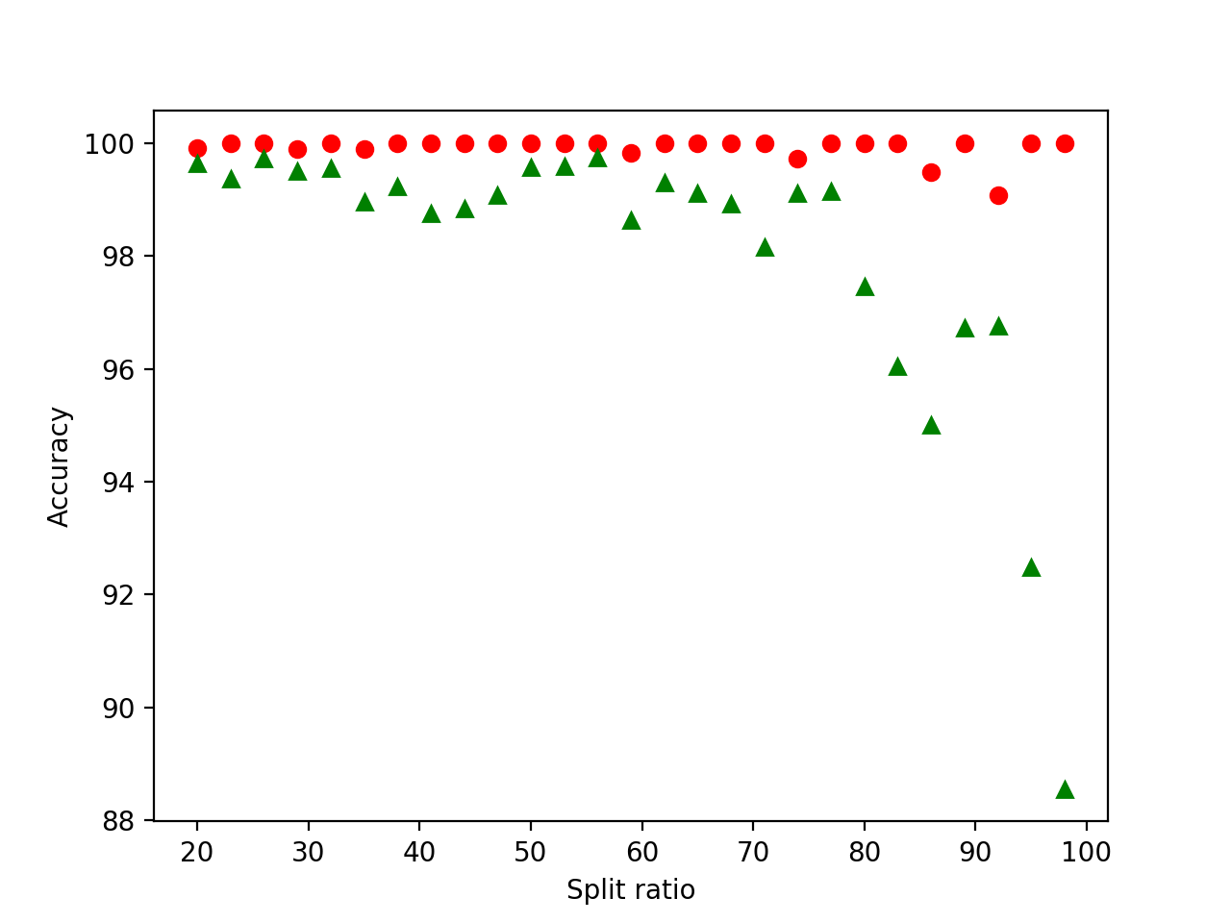
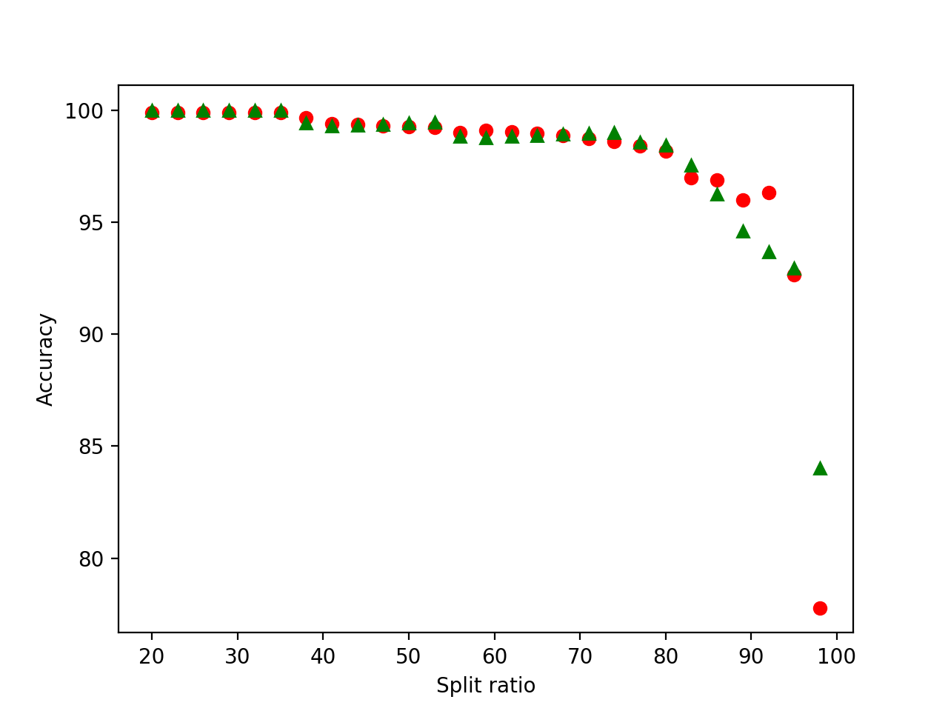
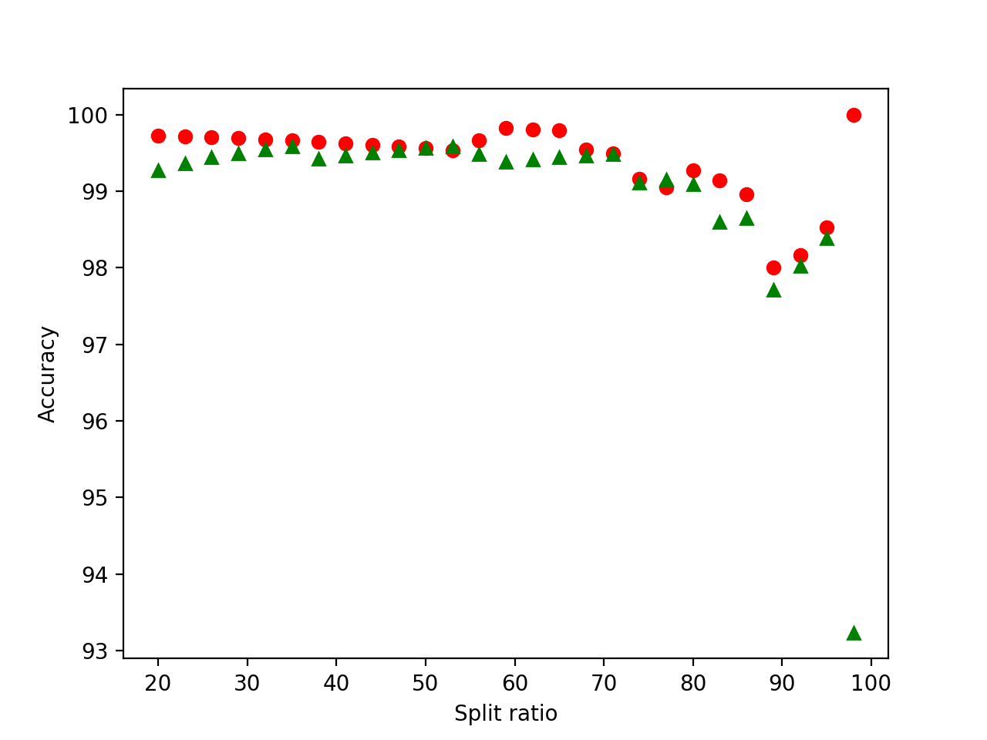
Bias Variance Curve
Training set
Test set
Neural network
Linear
Random forest
K-nearest neighbors
Gaussian

Slide 12
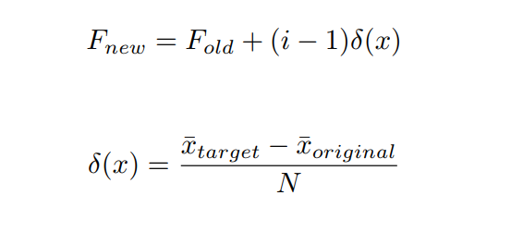
FROG BOILING ATTACK (FBA)
Only feasible when model is adaptive.
Works on concept of template drift.

Slide 13
FBA – Our implementation
Split dataset into training and test.
Fit training data, classify test set
Over N iterations
Calculate new corrupt data record.
Insert into training set.
Fit training data.
Classify the corrupt record.
If detected, stop. Else continue
Classify test set, and find differences.

Slide 14
Classifier accuracies post attack
Notes:
KNN & NN only misclassified the data point closest to the centroid we drifted towards.
Linear SVC & Gaussian misclassified several data points around the centroid.
Random Forest thwarted the attack at each stage.

Slide 15
The random forest anomaly
Our FBA didn’t work when we chose Random Forest
In fact
Accuracy increased.
Didn’t complete full iteration count.
Why?
Notes:
Why is Random forest immune to FBA? Possibly because Random forest constructs a bunch of decision trees at training time, and the output classification is the mean prediction of individual trees. Since we started with a data point that was furthest out from the centroid of the positive mean, it didn’t take the decision trees based on feature values closer to the positive centroid to weigh in against the tree on the edge. It has an inherent bias on the extremes.

Slide 16
Counter-measures to fbA
Freeze online training:
Easy to implement, but machine learning cybersecurity is often a tradeoff between security and responsiveness.
Autocorrelation functions:
Valid user inputs should feature no autocorrelation.
What does it mean to have correlations across time in user input?

Slide 17
Counter-measures to fba (batch updates)
A core assumption within FBA is that the model will not be able to detect small "drift" towards a target template
Batching model updates increases the magnitude of "drift", with the hope being that the model is able to successfully detect larger "steps" if we perform model updates in batches.

Slide 18
Counter-measures to fba (batch updates)
1
How do we choose an appropriate batch size for updates?
Empirically gather terminal iteration points (the number of iterations before our model “catches” a potential intruder).
Parameterize a Gaussian distribution and find the inverse CDF point that meets your accepted α.
2

Slide 19
FUTURE WORK
Ability to reproduce using iPhone / mobile device?
Is the process transferable to other image authentication problem spaces?
Is the model resilient to other types of attacks?

